Slide 1


Remote Monitoring and Other New Waiver Services
DODD Regional Training 2011

Slide 2
Change is Required
Solutions are Needed
27,000 people on waiting list
Workforce instability
  Direct support professional wages down
  50% DSP turnover
  80% reporting employees on public assistance
  Public DSP wages 73% higher
Budget
  Projected budget deficit of approximately 15%
  TPPT, State county board subsidies
  Uncertain economic outlook
Administratively complex
Unsustainable course for individuals and system

Slide 3
What do we do?
Everybody talks about the weather, but nobody does anything about it.
  Mark Twain

Slide 4
Remote Monitoring
Technology-enabled supports will supplant H/PC in residential settings
OPRA is working to ensure that efficiency dividends are reinvested in direct support professional wages, benefits, training and supervision and other priorities
OPRA, DODD and OACB are supporting a structured roll-out of remote monitoring that is thoughtful and measured in approach

Slide 5
Remote Monitoring Service –
Technology Enabled Supports
Fundamental right - access to technology in order to improve the quality of life
Use of technology to enable independence and integration in the community
Decreased reliance on paid supports
Must ensure health and safety
Changing the face of how services are designed and delivered
  Overnight monitoring
  Safety issues in the home

Slide 6
Some Guiding Principles
Useful
Affordable
Accessible
Easy to operate for end users
Value added

Slide 7
Remote Monitoring Service Req’ts
Prohibited in Adult Foster Care, supported employment or non-residential habilitation setting
Individual may request that remote monitoring system be turned off – backup support person must be on site
Timeline for backup support response in ISP
Monitor must be awake
HIPAA compliance required to ensure appropriate access only
Data retention for 7 years when Major Unusual Incident occurs
“Contracting” Options

Slide 8
Remote Monitoring Equipment Service
Visual indicator of equipment on and operating
Can only be turned off by remote monitoring staff
Covers a wide range of equipment including as approved by DODD

Slide 9
Remote Monitoring Equipment
Technology as a service
  Web-based monitoring system
  Live video or audio feed
  Pendant
  Camera/web cam
  Contact or motion sensor
  Seizure mat
  Radio frequency identification (RFID)
  Ultra mobile personal computing devices (UMPC)
  Smoke detectors

Slide 10
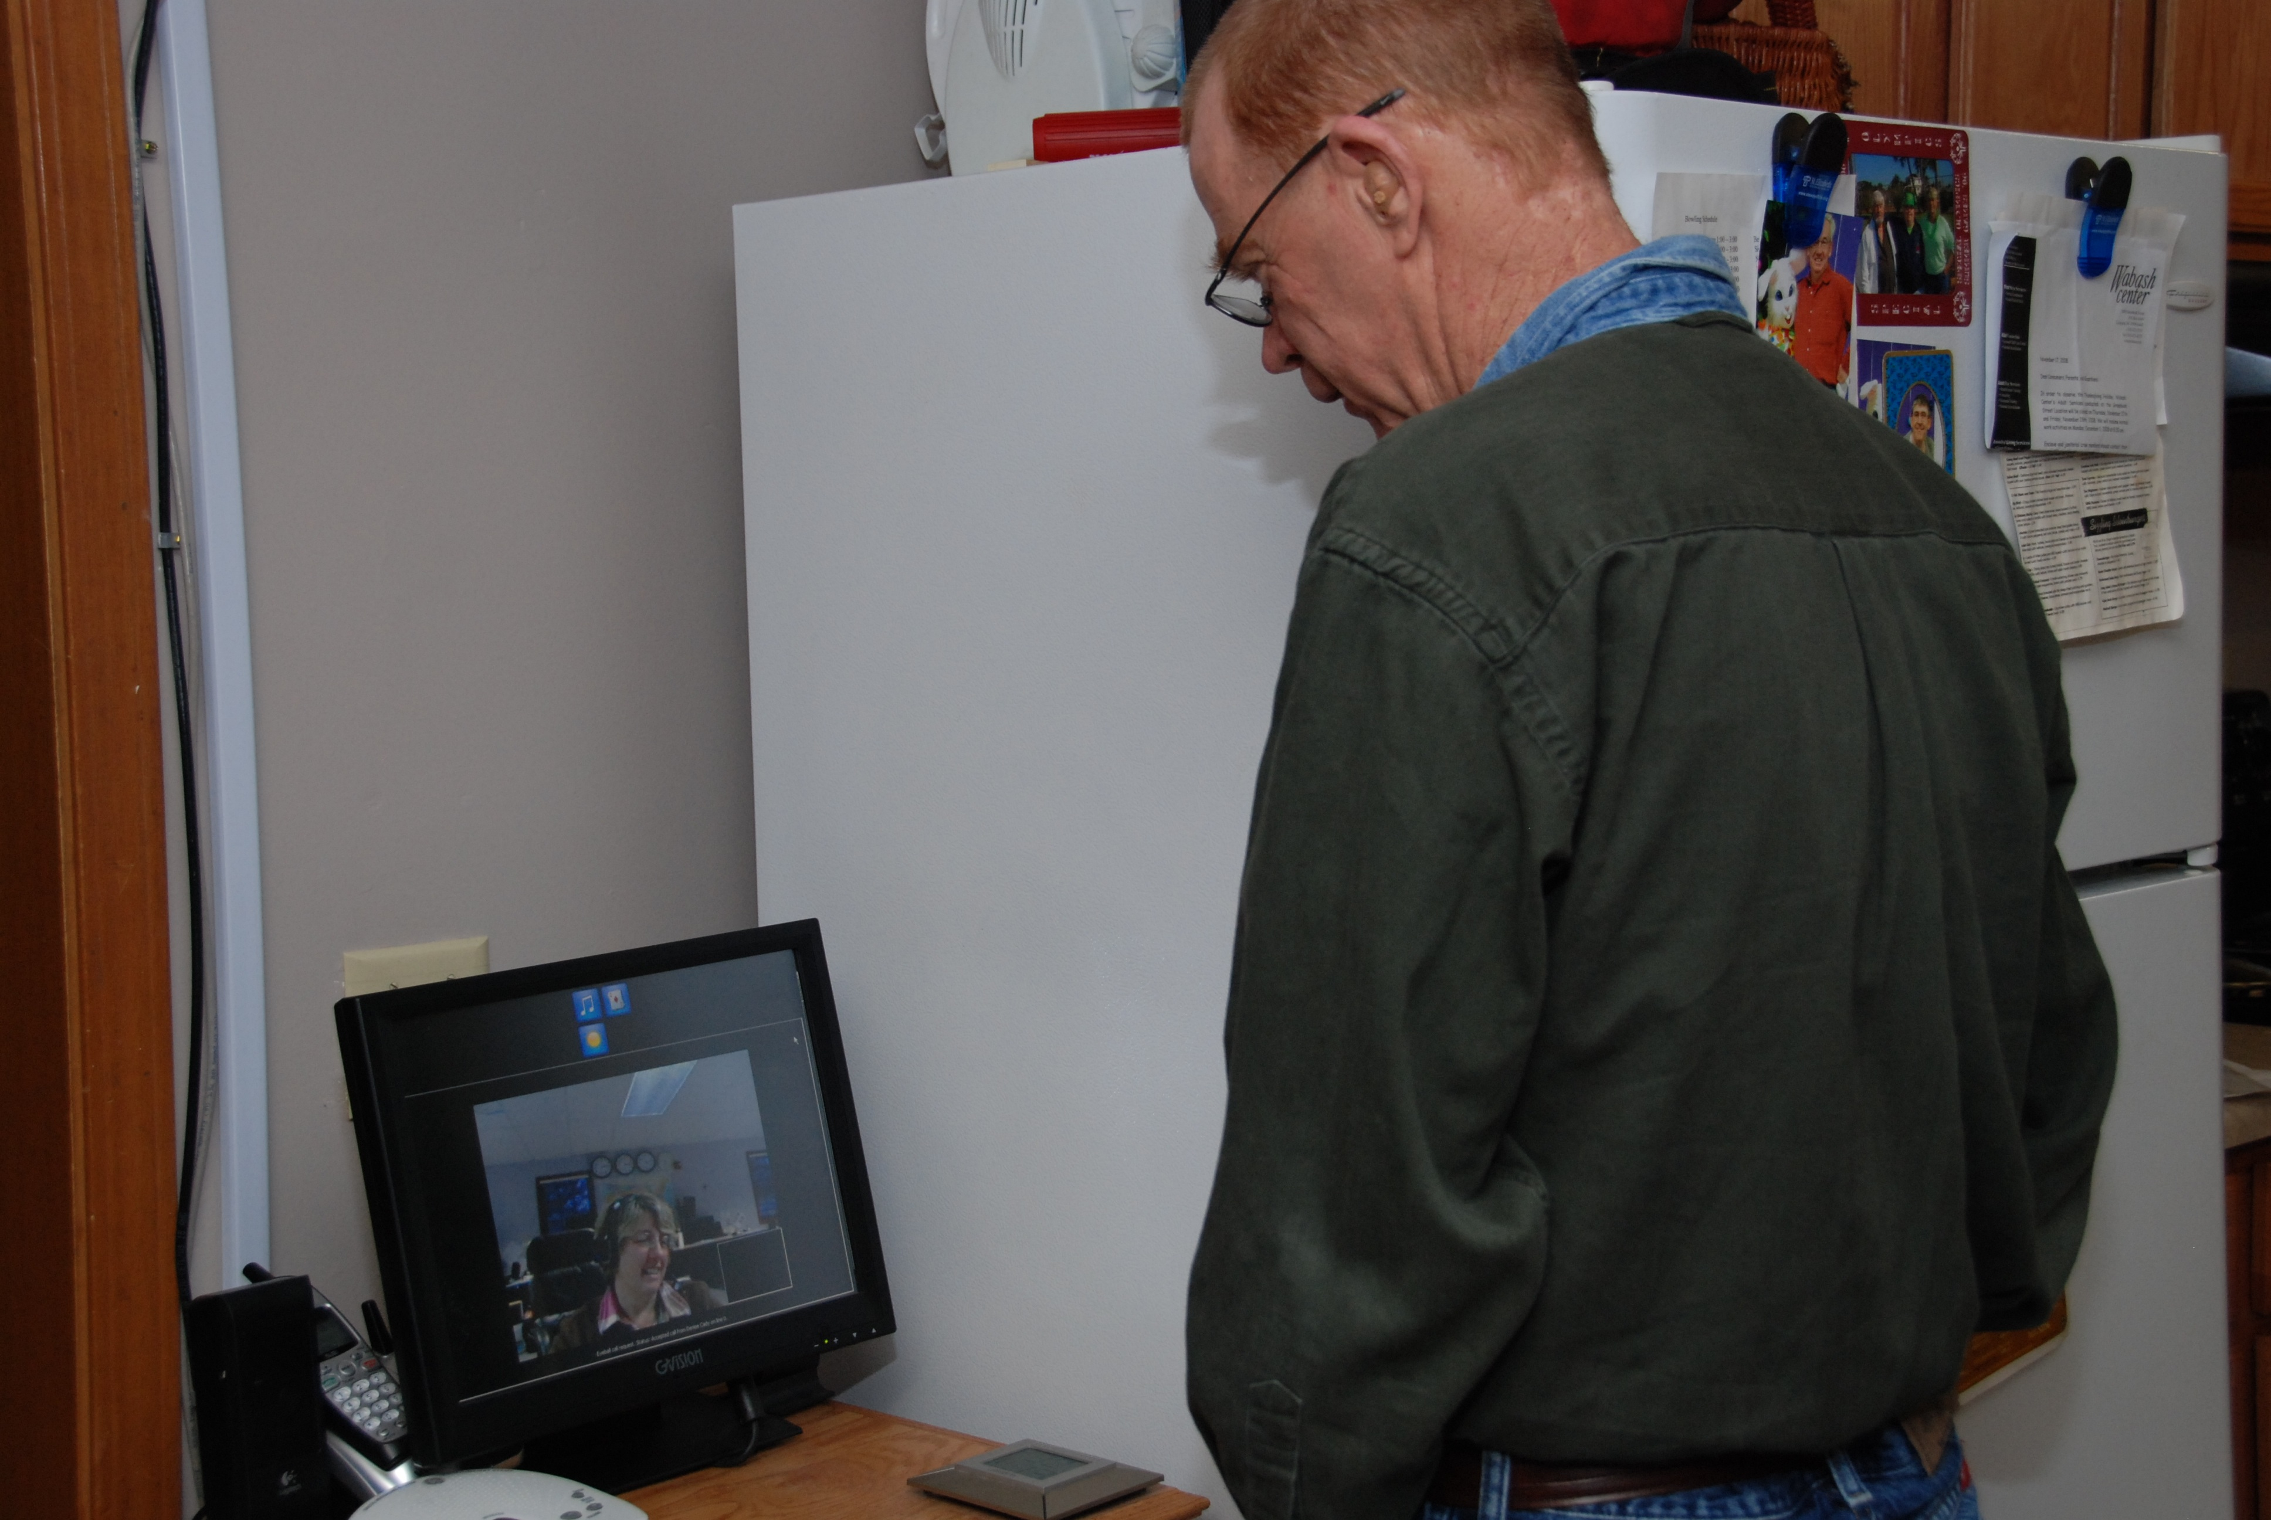
Two-Way Web-Based Communication

Slide 11
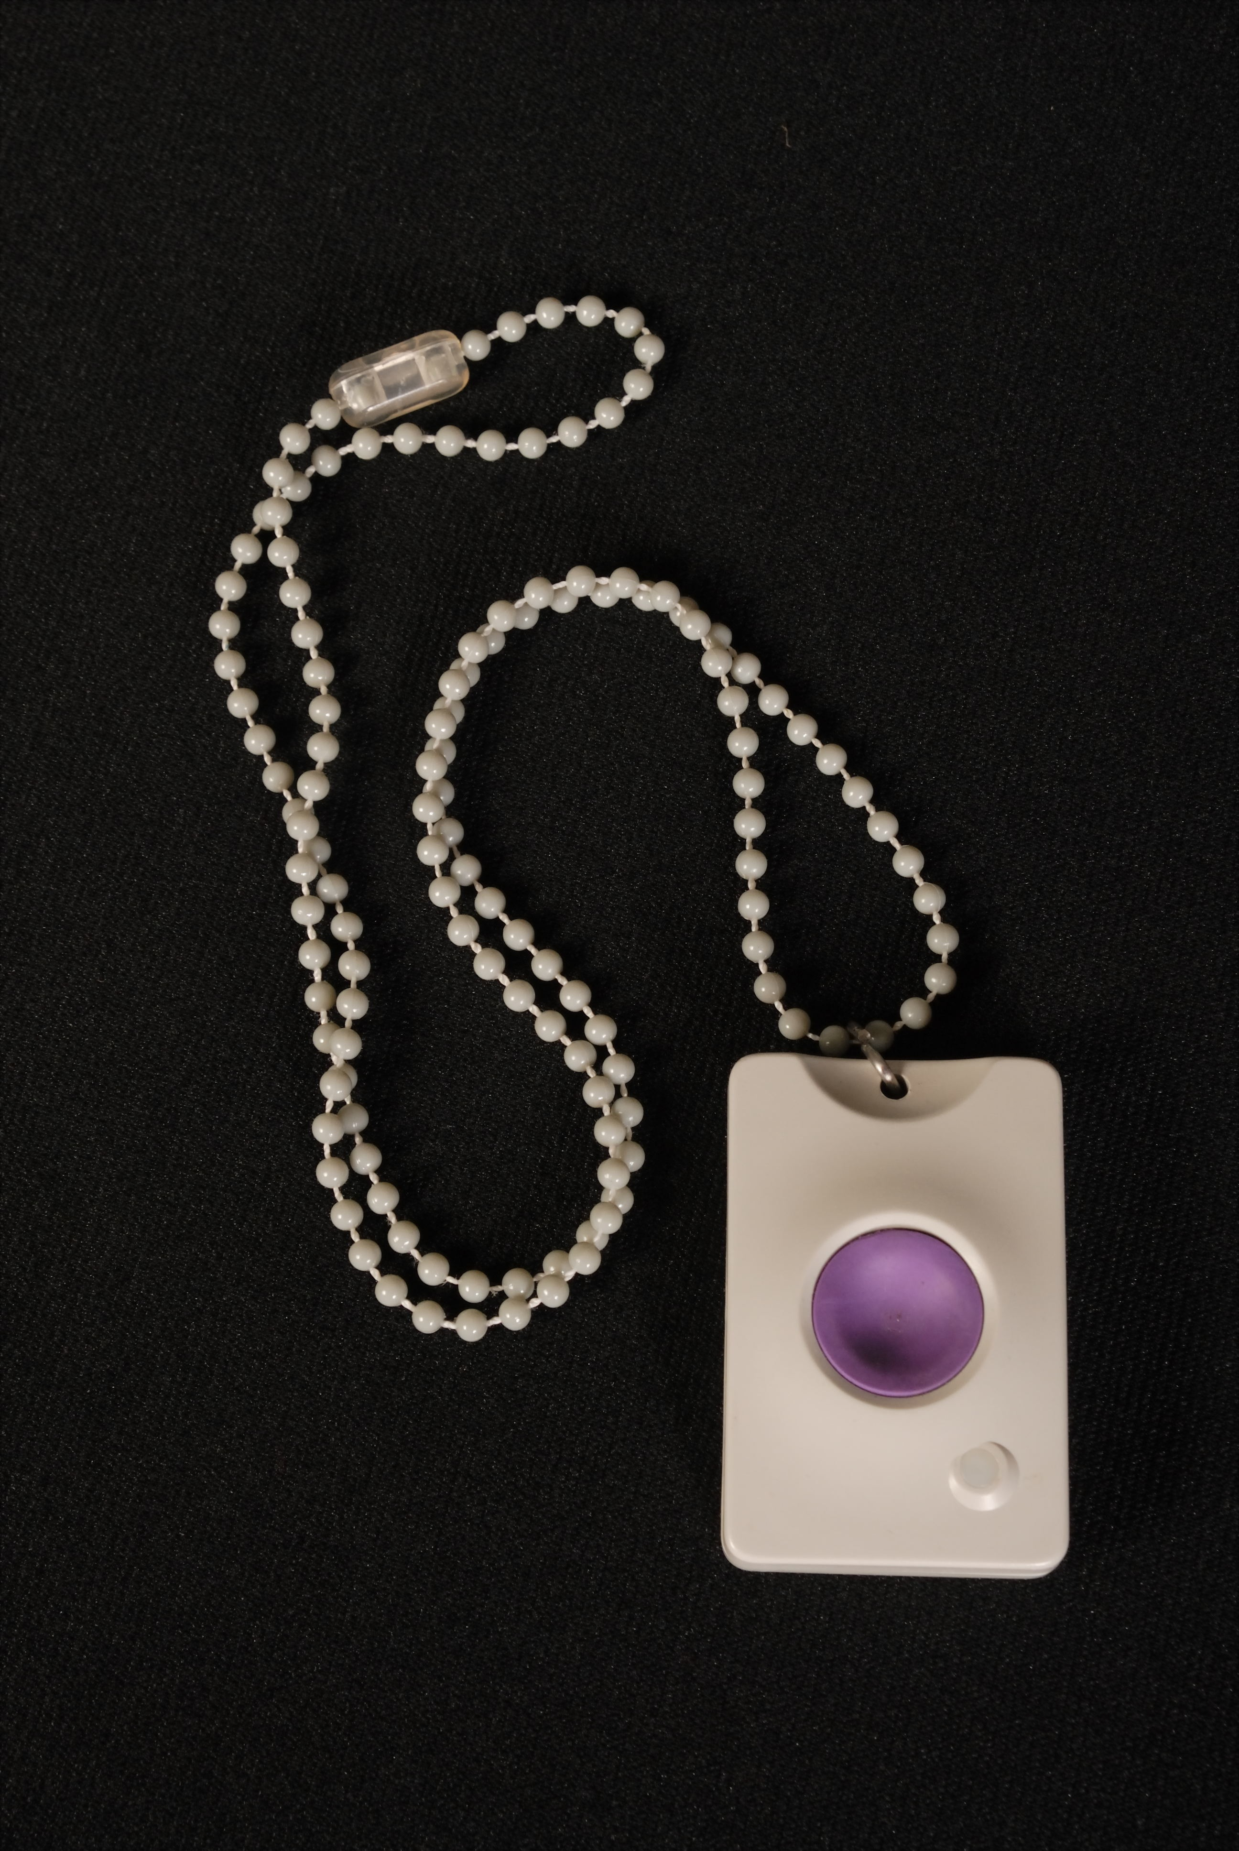
Pendant

Slide 12
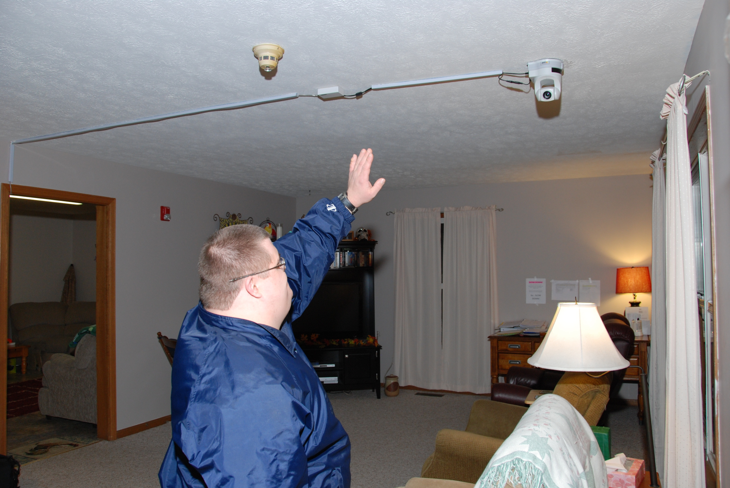
Pan, Tilt and Zoom Camera

Slide 13
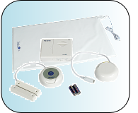
Seizure Mat

Slide 14
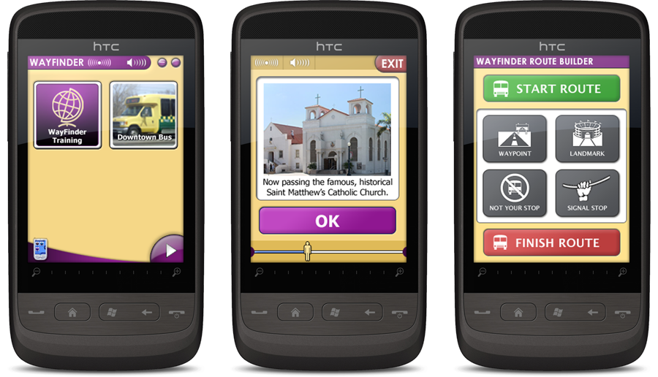
UMPC

Slide 15
Remote Monitoring Equipment Service
Equipment can only be leased and is limited to $5,000 annually
Amounts billed for the leased equipment shall be calculated based on:
  the cost of the equipment
  acquisition cost
  A reasonable percentage adequate to cover the cost of the provider's responsibilities as set forth in the rule
  A useful life of at least three years

Slide 16
REMOTE MONITORING DOCUMENTATION REQUIREMENTS
Date/Place of service
Name of individual receiving service
Medicaid identification number of individual
Name of provider
Provider identifier/contract number
Signature of the person delivering the service
Number of units of the delivered service or continuous amount of uninterrupted time during which the service was provided
Group size

Slide 17
Remote Monitoring Assessment
Developed by OPRA and OACB
Designed to simplify the assessment process used to determine appropriateness of remote monitoring service
Must ensure health and welfare
Available at: www.opra.org and www.oacbdd.org

Slide 18
Assessment Process
Designed for individual’s teams to use when they believe remote monitoring may be an appropriate service to consider.
The team would review the questions and answer yes or no with a brief explanation where applicable.
If an individual or guardian disagree with any plan to reduce HPC or replace it with remote monitoring, due process must be given.
If the provider disagrees with the SSA decision to implement remote monitoring, technical assistance is available from OACB and OPRA.

Slide 19
Remote Monitoring Service Planning
Guidance on including remote monitoring service in ISP
Process to be followed to ensure health and welfare
Assures compliance with rule and waiver document
Available at: www.opra.org and www.oacbdd.org

Slide 20
ISP Protocol
Simple checklist used to ensure that when remote monitoring has been authorized, a “remote monitoring plan’ has been developed and included in the ISP.
All appropriate safeguards should be clearly identified in the ISP including whether or not back up supports are unpaid family or paid staff.
Once informed consent has been given, payment authorization can occur.

Slide 21
Issues Specific to Recipients of Remote Monitoring
Independence
Community integration
Stretch funding resources
Privacy issues
Appropriateness
One example - Rusty

Slide 22
Issues Specific to the System
Providers incentive not resolved
Capitalization of software, equipment, staff and individual training
Data collection on savings
Reinvest efficiency dividends
  Direct care wages, benefits, training and supervision
  Waiting list
  State/county fiscal relief
Changing the face of how services are delivered
Importance of focusing on quality in time of diminishing resources

Slide 23
Rules for New Waiver Services
For additional information on these services, please go to http://www.registerofohio.state.oh.us/jsps/PublicDisplayRules/searchrulenumber.jsp to search for each service-specific rule.
5123:2-9-32 entitled "Home and Community-Based Services Waivers - Adult Family Living
5123:2-9-35 entitled "Home and Community-Based Services Waivers - Remote Monitoring and Remote Monitoring Equipment
5123:2-9-34 entitled "Home and Community-Based Services Waivers - Residential Respite and Community Respite

Slide 24
Thank You!
Mark Davis Lori Stanfa
Ohio Provider Resource Association Ohio Association of County Boards
1152 Goodale Boulevard 73 E. Wilson Bridge Road, Suite B1
Columbus, Ohio 43212 Worthington, Ohio 43085
614.224.6772 614.431.0616
mdavis@opra.org lstanfa@oacbdd.org

Slide 25
Supplemental Information
Presentations done at the 2011 OPRA Spring Conference are posted on the OACB, OPRA and DODD websites
These presentations highlight specific individuals assisted by technology, technology used and the outcomes achieved
The inclusion of these presentations does not imply an endorsement of these or any remote monitoring vendor and are included for informational purposes only

Slide 26
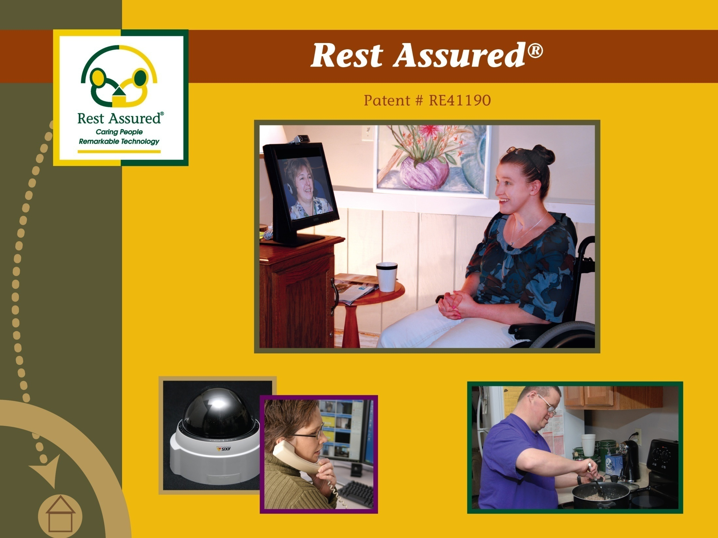
Notes:
Introduce myself

Slide 27

Case Studies
Notes:
Intro of the 3 case studies
Explain why they were chosen
Low to high level of need
Support budget impacts
Differences in care plans vary significantly
Purpose of support needs are different
Mary: to stay at home and be independent as possible
Bob: Avoid roommate situation and protect against exploitation
Jane: Protect health/safety and to stay in community setting

Slide 28
Source of Information
Notes:
Interview
Family, provider, telecaregivers, staff
Care Plans
Prior to RA and RA care protocols
System Configuration
RA System

Slide 29


MEET MARY
Age: 20
Primary: Mild MR (Downs Syndrome)
Secondary: Seizure Disorder (infrequent), Speech Difficulties
Behavioral: None
Medical: Infrequent Seizures
Desires: Independence (be at home alone)
Living Situation: Family Home
Notes:
Speech:
Expressive = 2nd grade level
Receptive = 7th grade level

Slide 30
Good At
Socialization (cell phone)
Medication administration
Uses PC
Personal care needs
Struggles With
Stranger safety
Knowing her limits
Being alone for long periods
Dietary restrictions
Requires Assistance
Using oven/stove
New tasks with multiple steps
Notes:
Socialization
Has boyfriend that she talks to on cell phone
So much so that parents have to limit how often she calls people (must notify us prior to calling someone)
Has friends over
Medication Adm
Uses pill organizer
We only ask if she has remember to take medications
Stranger Safety
Will open door for strangers
Has list of approved visitors during monitoring times
Dietary Restrictions
Allergic to wheat/gluten; has gluten free snacks
Portion controlled diet
Has preapproved foods on a specific shelf in food pantry and refrigerator

Slide 31
Supports Prior to Rest Assured
Notes:
Takes bus to school in am
Goes to school
After school program or……
Takes bus home from school
Parents and/or sister would have to be home with her
Natural Support
Dance classes

Slide 32
Mary’s Desires/Goals
Family’s Desires/Goals
Maximize independence
Be home alone
Continue social life
Feel safe at home alone
Health/Safety needs met
Maximize independence
Protection from outside
ADL assistance
Personal growth
Decrease need for unreliable staff

Slide 33
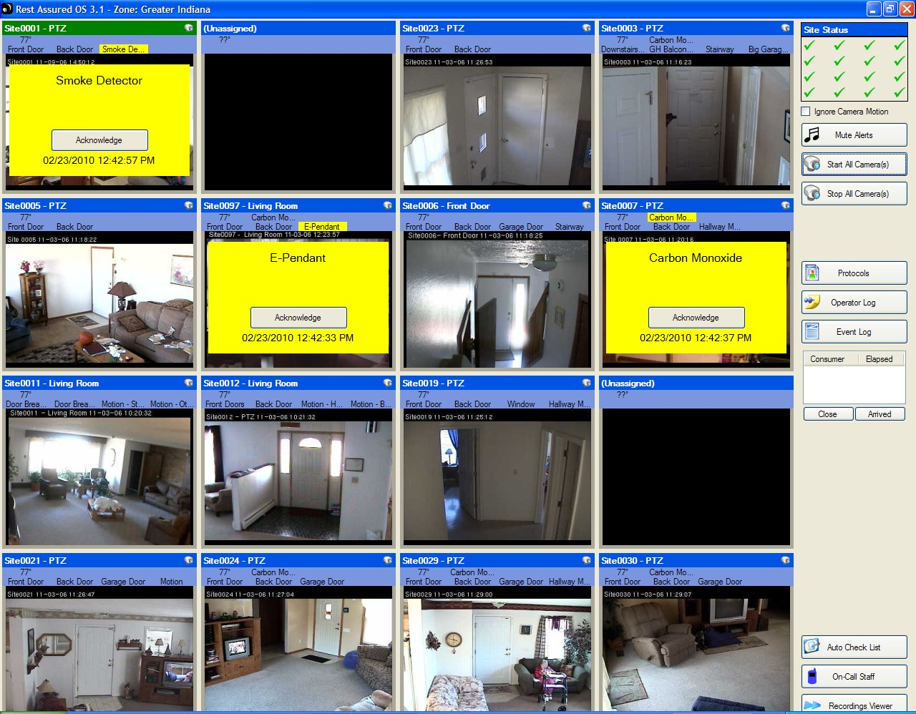
Technology Supports
ACTIVE SUPPORT
Continuous oversight/support
Family gives RA weekly schedule
Occasionally - On-Demand
3rd Party Access
Family monitors
Mom & dad from work
Dad travels and does virtual
visits
Sister at college also provides support

Slide 34
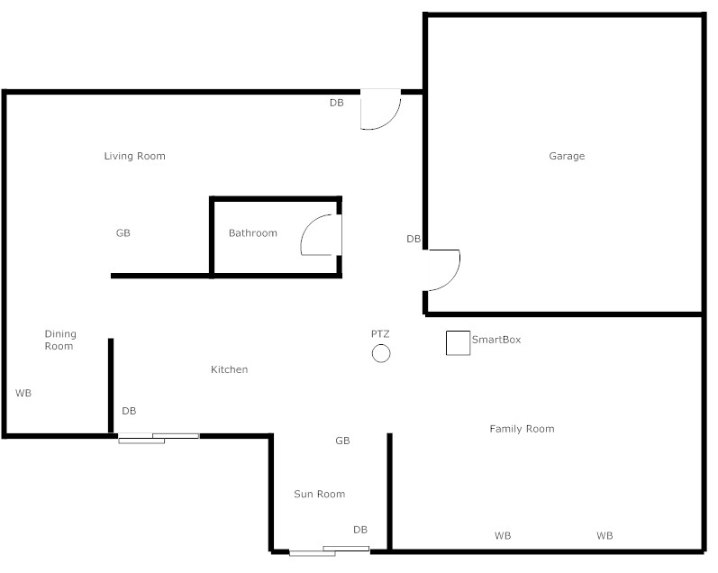
Main Floor

Slide 35
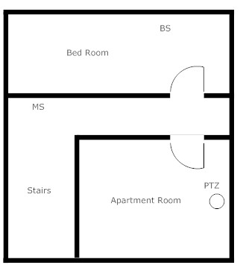
Upstairs

Slide 36
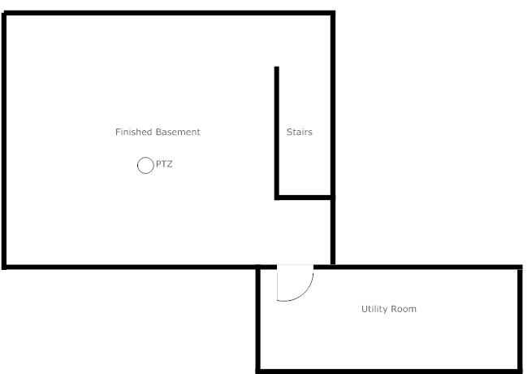
Basement

Slide 37
Programmatic Issues/Challenges
Family
Rest Assured
Self Directed Waiver funding
Protecting family privacy
Designing care protocols
  Grade card
  Practicing routines
Coordinating with other providers
  Taxi service
  Local licensing
  Police
Interface with AI phone
3 floor installation – electrician
Monitoring schedule
Detailed care protocols
Communication with family
Notes:
Grade Card
ABCDF
Doesn’t open door until ok’d by Tele-Caregiver
Assists with AI phone
Wears ER pendant
Notifies Tele-Caregiver when going to basement, eating, or using phone
Complies with verbal requests around food

Slide 38
Outcomes for Mary

Slide 39

Outcomes for Family
Peace of mind
Family remote support
On-demand Tele-caregivers
Both parents can continue to work
Stopped revolving door of direct care staff
  Scheduling, no-shows, etc.
Cost savings after 1.5 years (purchased equipment)

Slide 40

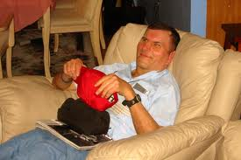
MEET BOB
Age: 34
Primary: Mild MR
Secondary: Cerebral Palsy, Hearing impairment
Behavioral: Manipulative, physical assault, refusals, verbal abuse, temper outburst, exploitation by others
Medical: None
Desires: Independence, NO roommates, alone time without staff
Living Situation: Supported Living (no roommates)

Slide 41
Good At
Self directing
Friendly & sociable
Struggles With
Being too trusting of others
Living peacefully with others
Compliance with staff direction
Managing frustrations
Requires Assistance
Transportation
Community Inclusion
Notes:
Good At:
Lets you know what he likes/wants and what he doesn’t
Loves talking with people, going to hooters, etc

Slide 42
Supports Prior to Rest Assured
Notes:
Natural Support
Dance classes

Slide 43
Bob’s Desires/Goals
Family’s Desires/Goals
Maximize independence
Be home alone
NO roommates
24/7 support
Health and safety needs met
Protection from others
ADL assistance
Personal growth
To be happy

Slide 44
Technology Supports
ACTIVE SUPPORT
Continuous Oversight/Support
Set schedule of 8 hours/day
Weekdays 11p-7a
Weekends 9p-9a
Emergency Watch
Monitoring via sensors for emergencies
Weekdays 7a-9a & 9p-11p
Weekends 9a-11a & 7p-9p

Slide 45
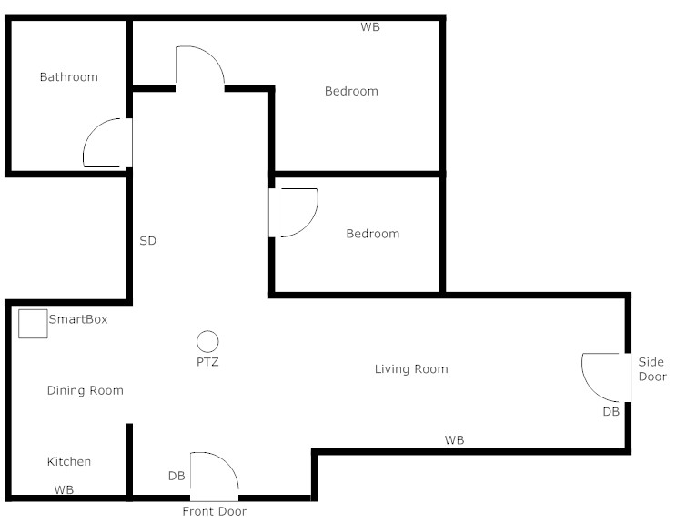

Slide 46
Programmatic Issues/Challenges
Provider
Rest Assured
Needed to find a way to provide 24/7 support with limited budget
How to structure on-call staff for only one home
Getting family “on-board”
“Post honeymoon phase” reality
Dealing with non-monitoring time requests
Staying neutral with feuding family & provider

Slide 47
Outcomes for Bob

Slide 48
Outcomes for Provider
Positives
24/7 support within budget allocation
Decrease in staff related behavioral episodes
Flexibility in hours of support
3rd party access
Negatives
Administration of telecare services

Slide 49
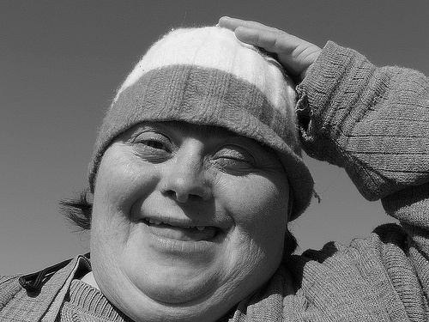
MEET JANE
Age: 37
Primary: Mild MR
Secondary: Intermittent explosive disorder, borderline personality, bi-polar
Behavioral: Self-injurious behaviors, pica, attention seeking, false accusations, overindulge in sugar
Medical: Diabetes, obesity, psychogenic seizures
Desires: Independence
Living Situation: Supported Living

Slide 50
Jane’s History
Notes:
Supported Living w/Roommate
Lived with partner who died of drug overdose
She was very close to her
Set’s Apt on Fire
She didn’t leave. She sat calmly in chair and made no attempt to leave. A neighbor saw her as he was leaving and had to drag her out.
Group Home
Lots of false accusations against staff and other residents (accused staff of rape).
Traumatized roommates
State institution
Only stayed 90 days
Mom’s house
Frequent call to police (attention seeking)
Suicide attempts and threats frequent
Mom couldn’t manage without assistance
Supported Living Alone
2:1 staffing due to false accusations and risk for staff injury
24/7 eyes on (staff sat in her room and watched her sleep)
Dog would attach staff and neighbors
Would refuse staff and lock staff out and police would need to be called for well check

Slide 51
Good At
Meal prep
Self care with prompting
Struggles With
Managing diabetes
Following dietary requirements
Requires Assistance
Medication administration
Notes:
Medication adm
-history of trying to overdose
Fairly high functioning

Slide 52
Supports Prior to Rest Assured
Notes:
Natural Support
Dance classes

Slide 53
Jane’s Desires/Goals
Provider’s Desires/Goals
Independence
Group living won’t work for her
Stay in her apartment
Not have staff in her bedroom
Reduce cost of 2:1 staffing
Combative with staff
Protection against false accusations
Health/Safety of Jane
Give some feeling on independence to Jane
“Decrease the drama”
“Just manage day to day with her”
Notes:
Stay in her apartment
-not return to state institution

Slide 54
Technology Supports
ACTIVE SUPPORT
Continuous Oversight/Support
24/7
Staff in home from 7a-10:30p

Slide 55
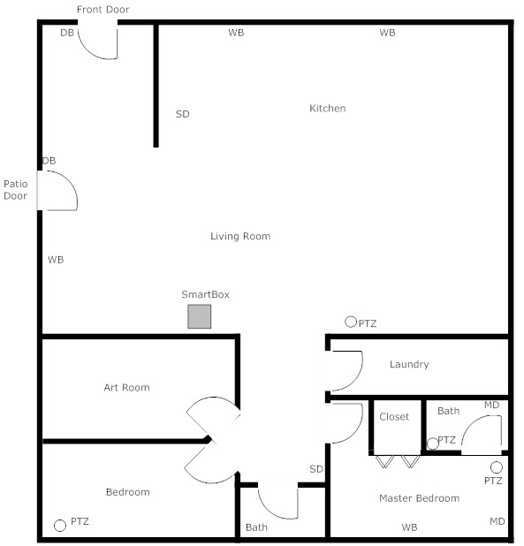

Slide 56
Programmatic Issues/Challenges
Provider
Rest Assured
Camera location to protect staff while protecting Jane’s privacy
Uncertainty of how she would view privacy aspect
Private time
Controlling environment
Back-up staff set-up
Significant attention seeking
Implementing/training on BSP
Tele-Caregiver overcoming privacy concerns
Coordinating with on-site staff
Interacting with police officers
Notes:
Private time
-allowed 15 minute blocks of time in bedroom/bathroom without cameras on
Controlling environment
-locking up all sharps
-making sure all non edibles are locked
-

Slide 57
Outcomes for Jane
Notes:
Decreased behaviors
-we can give attention she seeks

Slide 58
Outcomes for Provider
Lower staff turnover
“Managing day to day”
“Cost savings of $43,431 per year”
Few incidents involving law enforcement
Few behavioral episodes
Video recording of everything (false accusations)
Ability to keep her within their agency

Slide 59
Ethical Issues
Group Discussion

Slide 60
OUTCOMES

Slide 61
Dustin Wright
General Manager
Rest Assured®
877-338-9193 x 348
dwright@restassuredsystem.com
www.restassuredsytem.com

Slide 62

Sengistix
Remote Monitoring
Case Studies

Slide 63

A Little Independence for Jake
Age: 19
Diagnosis: Fetal Alcohol Syndrome resulting in mild mental retardation,
Behavior: *Truancy
*Not coming home after school
*Socialize with others who take advantage of him
*Lack of impulse control
*Verbal aggression
Medical: None

Slide 64
3rd Street Program

Slide 65
Jake

Slide 66
Jake – NEED/PROBLEM

Slide 67
Jake - PLAN

Slide 68
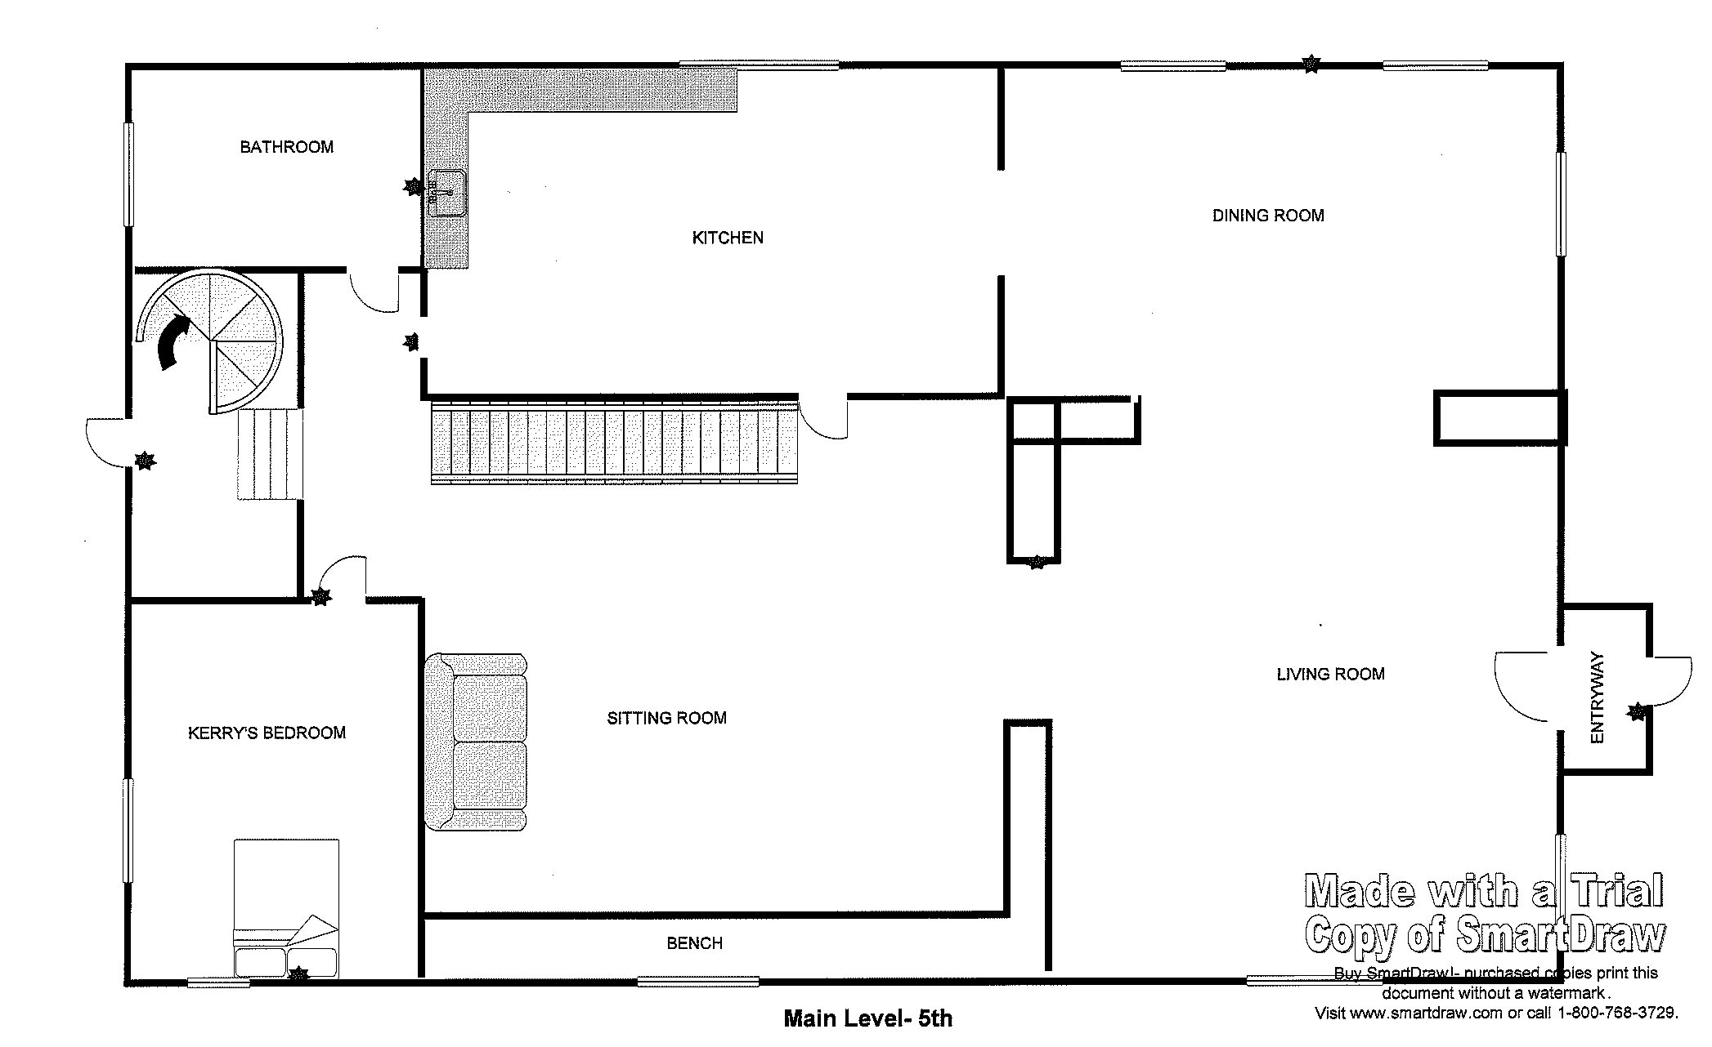
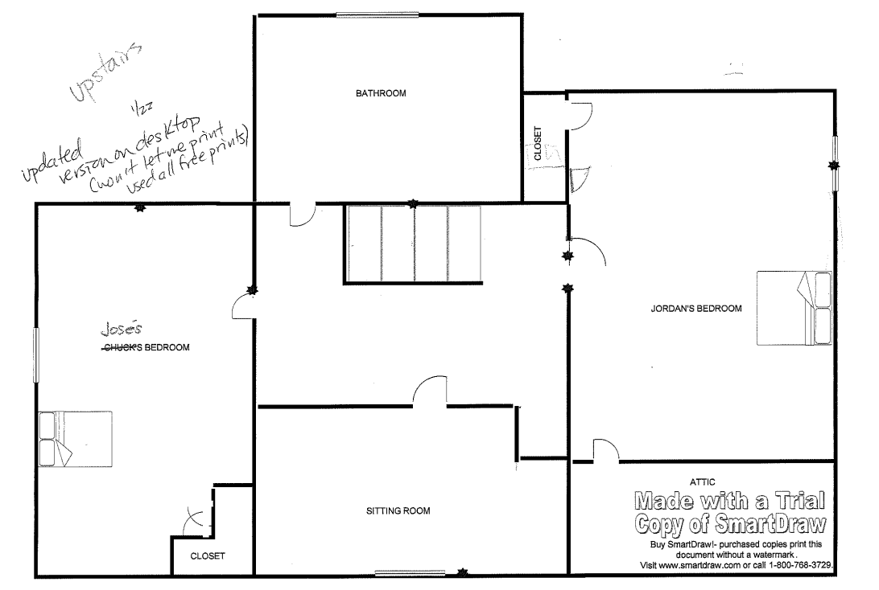
3rd St. House
Camera
Motion
sensor
Motion
sensor
Back Yard – Door Jake uses when has a smoke at night. Alert sent if doesn’t come back in, in 10 min
Contact
sensor
Motion
sensor
Front and Main Entry – Out to Street
Contact
sensor
Jake’s routine is to come in front door, and go directly to his room.
Lower level
Active Monitoring would start at 2:00 PM. Sengistix Advocates would wait for the contact sensor on the door and motion in the house.
Advocate checks the camera to verify it’s Jake and that he’s alone, both on entering the house and when going down stairs.
Motion
sensor
Contact
sensor
If Jake left his room, advocates would monitor him. He would usually go out the back yard to smoke and return within 10 minutes.
Motion
sensor
Camera
Contact
sensor
Jake
Motion
sensor
Motion
sensor

Slide 69
Jake - OUTCOME

Slide 70
Jake - OUTCOME

Slide 71
APARTMENT MODEL

Slide 72

APARTMENT MODEL

Slide 73

A Family United –
Julie, Devin and Josh
JULIE
Age: 25
Diagnosis: Dysthymic Disorder and Borderline Intellectual
Functioning
Medical: None
Employment: Walgreens – night shift
DEVIN
Age: 27
Diagnosis: Mild MR and Delay in
Development, unspecified
Medical: None
Employment: Car Wash - days
JOSH
Age: 18 months
Diagnosis: None
Medical: None

Slide 74
Family United

Slide 75
Overnight Supervision

Slide 76
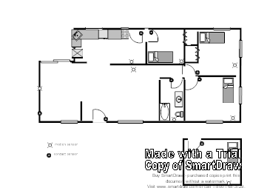
Overnight Supervision
Motion in Frank’s room starts monitor. If followed by back door open, timer set for 15 min. If door not re-opened and motion in Frank’s room within 15 min. alert is sent.
Stove guard shuts stove off if no movement in kitchen in 10 min 24/7.
Back Door
Each person has a call pendant to use if need help, have a concern, want staff.
If Front, Patio or Garage doors open between 10:30 pm and 6:00 am, an alert is sent.
Garage Door
Front Door
Motion sensor
Call Pendant
Whenever smoke detector goes off, alert is sent. At night goes to response staff, during day to supervisor.
Contact sensor
Smoke Detector with Remote Alert
Bed sensor
Stove Guard

Slide 77

Overnight Supervision - PLAN

Slide 78
Overnight Supervision - COST

Slide 79
Overnight Supervision - OUTCOME

Slide 80
DISCUSSION
Questions
Ethical considerations
Other ideas
Potential barriers
How to talk to stakeholders

Slide 81
CONTACTS
Sandy Henry, Senior Director
Cell: (651) 216-3645
Email: Sandy.h@sengistix.com
www.Sengistix.com
customerservice@sengistix.com

Slide 82

Part II

Slide 83
Using Technology
Improve Consumer Services/Supports
  Assess Service/Support Needs
  Facilitate Communication/Involvement Families
  TeleHealth/Education
Improve Organizational Efficiency/IT IQ
  Coordinate Information
  Assess/Evaluate DSP (Direct Service Professional)
Engage in Research and Development
  Design/Develop New Products
  Demonstrate Success/Failure
Create New Service Models
  Address Waiting Lists
Establish/Develop New Partnerships
  Social Ventures
Notes:
83

Slide 84

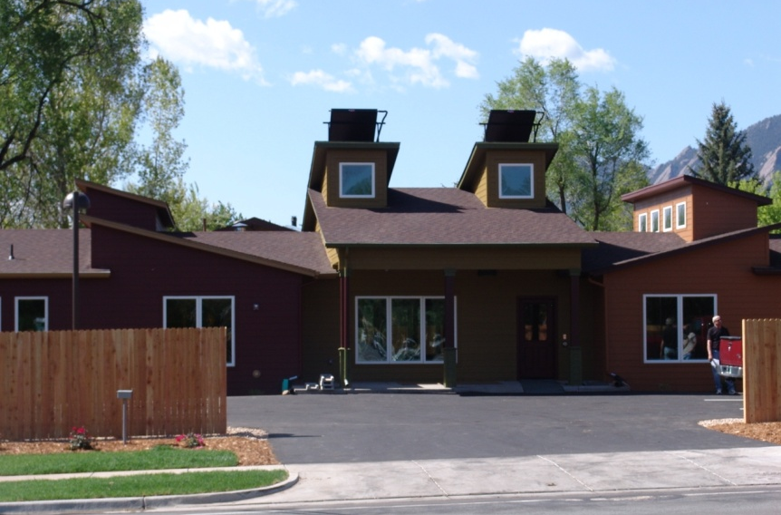
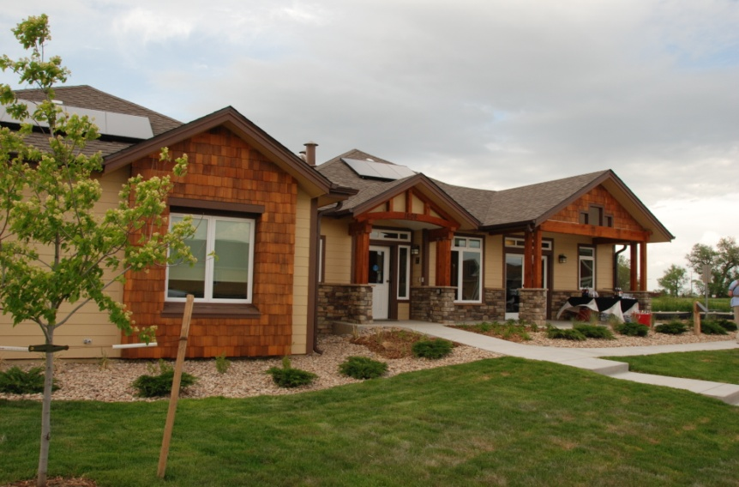
Imagine! SmartHomes
Bob and Judy Charles SmartHome, Boulder, CO
Charles Family SmartHome, Longmont, CO
Notes:
Next step in our innovation – SmartHomes – use technology to improve quality of life and efficeicy of srvices and cost savings – two of them
First in the nation
Also a working laboratory
Unique approach in our industry

Slide 85
The goal of the Imagine! SmartHome: Through the application of technology, we will improve the quality, efficiency and access of supportive services for individuals with developmental and other disabilities in a permanently affordable, cost effective, and energy efficient community setting.
http://imaginesmarthomes.org
Notes:
85

Slide 86
Funding
Notes:
86

Slide 87
Participatory Process
Consumer/Family Involvement
  Design
  Selection Process
  Outline Expectations
House Guidelines
Consumer/Family Satisfaction
Technology Assessment/Evaluation
Notes:
87

Slide 88
Areas of Technology
Consumer Specific Supportive Services
Family Communication and Access
Operational – Management and Line Staff (DSP) Support and Information
Environmental – Home Management and Monitoring Systems
Notes:
88

Slide 89
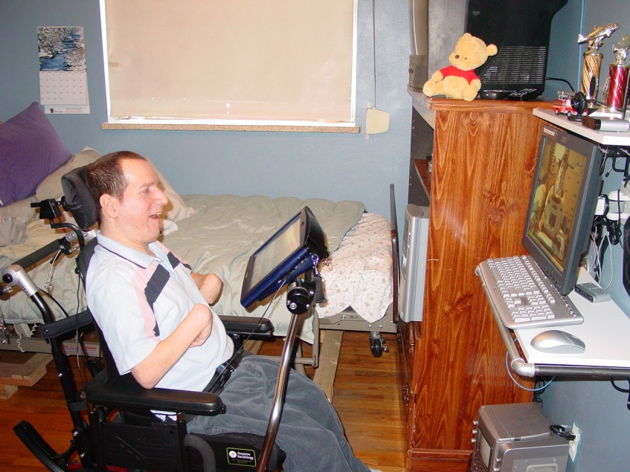
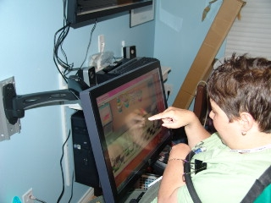
Consumer/Family Specific
Universal Interface - UMPC
  Environmental Control System
  Communication – VOIP
  RFID, IR and GPS Capable
  Teaching and Prompting Systems
  Family Information Systems
Notes:
89
These technologies are cognitive support technolgies

Slide 90

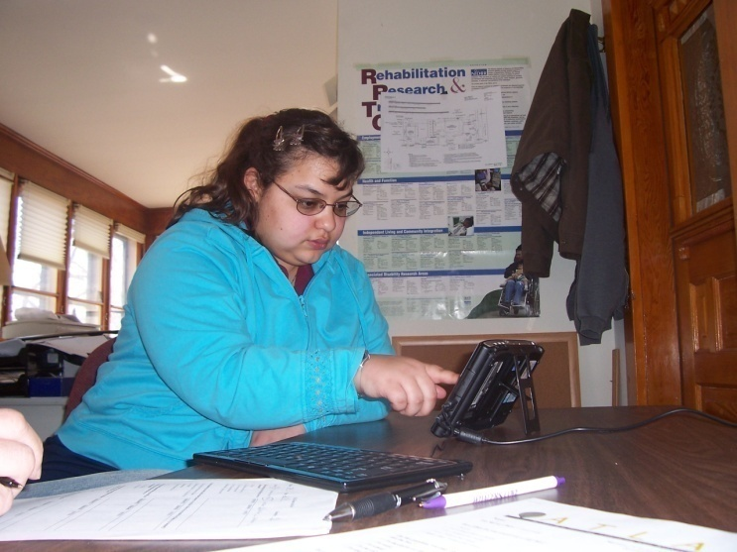
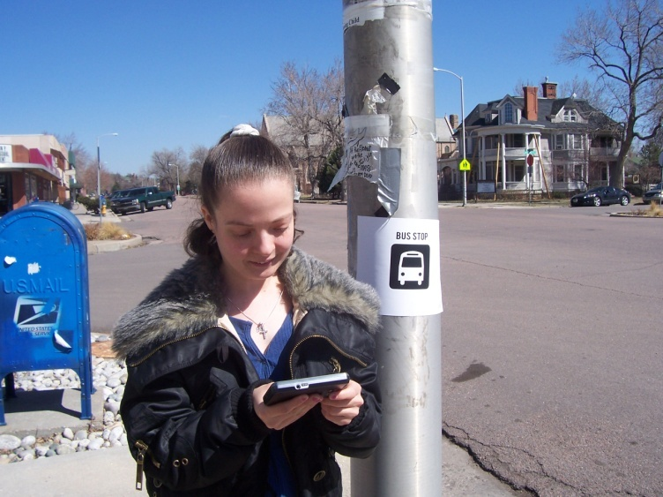
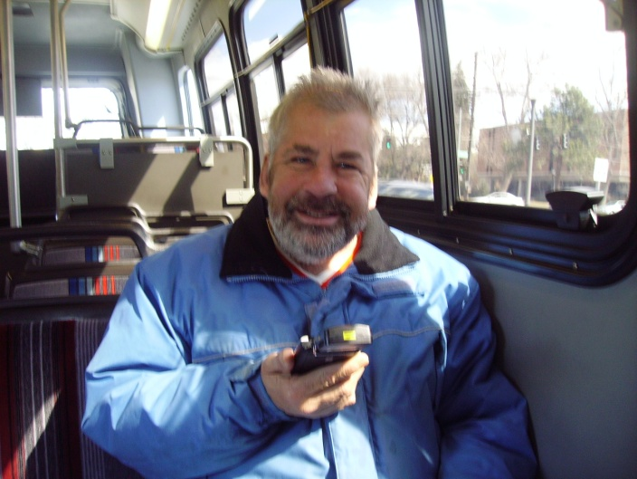
NEEDS-DRIVEN,
PERSON-CENTERED TECHNOLOGY
What is Cognitively Support Technology?
Simply, Good Design!

Slide 91
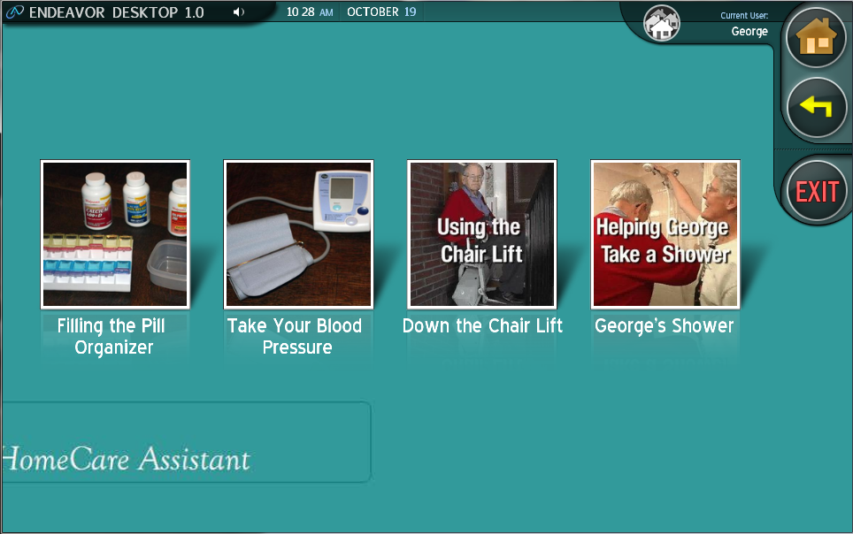
Prompting Technologies for Task Support
Endeavor Desktop Environment – Task Prompter

Slide 92

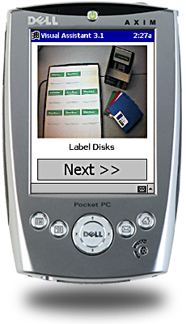
Prompting on Mobile Devices
Available
Personalized task prompting on a PDA using customizable
visual and auditory step-by-step instructions with pictures or video.
Visual Assistant – Mobile Device Task Prompter

Slide 93
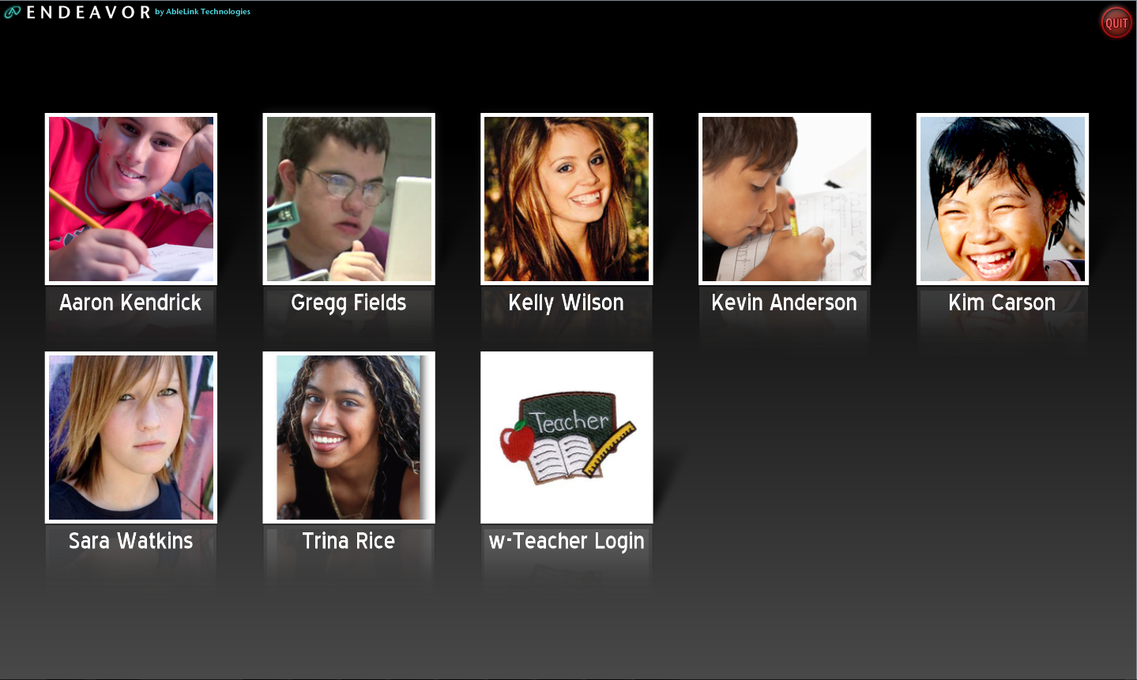
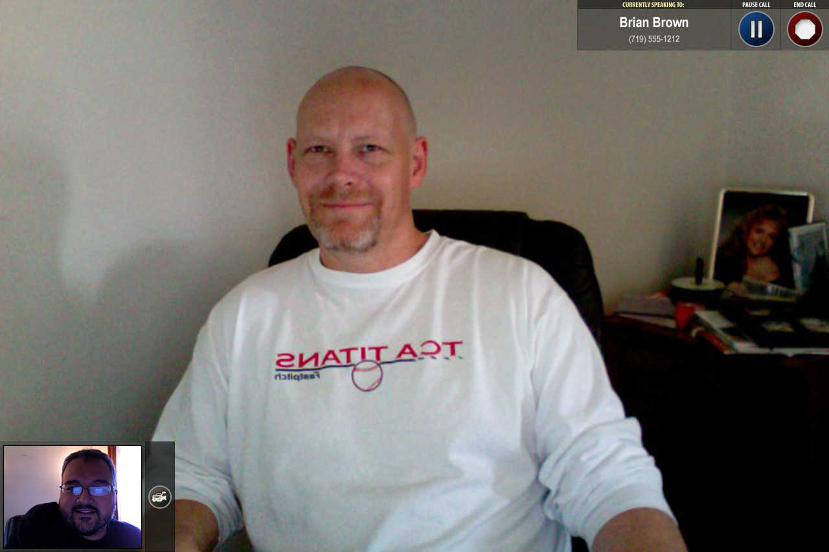
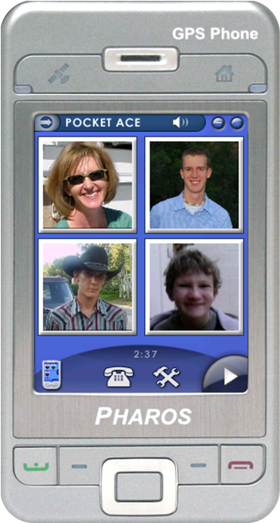

Visual Communication Tools
Available
Cognitively accessible “Skype” for desktop communication, picture-based cell-phone for mobile communication.
Pocket ACE – Developed in collaboration with Univ of Kansas
Visual ACE – Developed in collaboration with Imagine!

Slide 94
Operational
SaaS Model
  Management Interface -Browser Based
  Employee Time Tracking
  DSP Interface - Browser Based
  Automate Documentation
    Incident Trending
    Care Plans
    Billing/Utilization
  Multiple Platform Integration
  LMS
  Family Access/Portal
Notes:
94

Slide 95
Changing Static to Dynamic
Consumer Actions
Learning/Independence
Direct Care Interactions
Billing for Reimbursement
Notification and Prompting
Health/Wellness
Family Involvement

Slide 96




Using RFID Information
Staff
Members
Staff Members
  Alerts & Notifications
  Live View
  Care Zone Summary
  Performance Metrics
Support
Network
  Live View
  Historic Trends
  Health information
  Social information
Clients
CARE System
Managers
  Global Perspective
  Client Overview
  Employee Overview
Managers
Notes:
The CARE System collects information from disparate sources, to creates views of information relevant to each role within the support network.
From staff members collect information from sensors (such as location and alert response), just in time log in of services provided, and their use of the web-based information portal.
From clients we collect information about their movement throughout the environment, and also from alerts they generate
Managers provide the system with definition by completing profiles of Clients, and setting appropriate alert and notification preferences.
The CARE Station translates this data into information relevant to each role:
actionable cues for staff members: Alerts and notifications
social and health information for client contacts (the support network)
Global perspective for managers
96

Slide 97
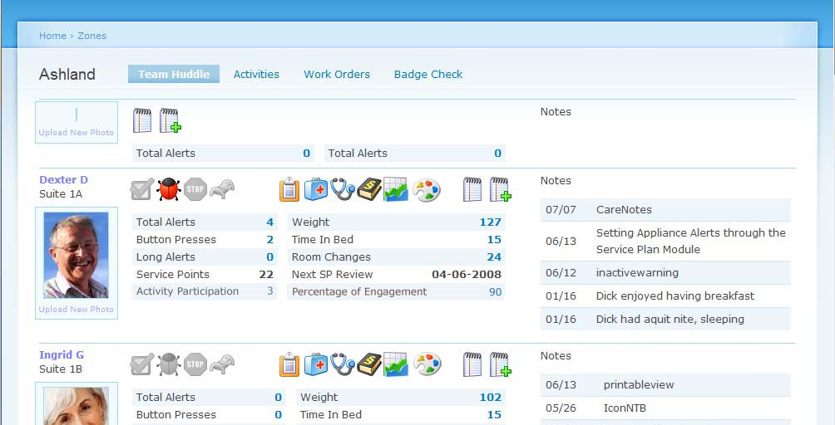
Client Summary
Information Summary and Documentation Hub
* Metrics * Communication * Quick Documentation *
Notes:
The Client Summary brings system information together and makes it meaningful for staff members.
This view brings staff members up to date on what happened since they were last on shift.
They can review the last 24 hours of information collected by the system such as movement, total alerts, and time spent in bed.
This is also a place to quickly read and document observations.
Because the information system is web based, managers and on-call nursing staff can access the CARE portal online, and allowing the team members to consult one another with an established and accessible point of reference.
97

Slide 98

Medication Administration and prompting system
Intuitive User Interface improves efficiency and accuracy
Easily manage staff and medications records from a central location or remotely
Improved compliance with Medication Administration
Improved communication between DSP and Nursing
75% reduction of medication administration errors
Reduces staff training by 18 hours per residence
Integrated with Pharmacy to reduce transcription errors

Slide 99
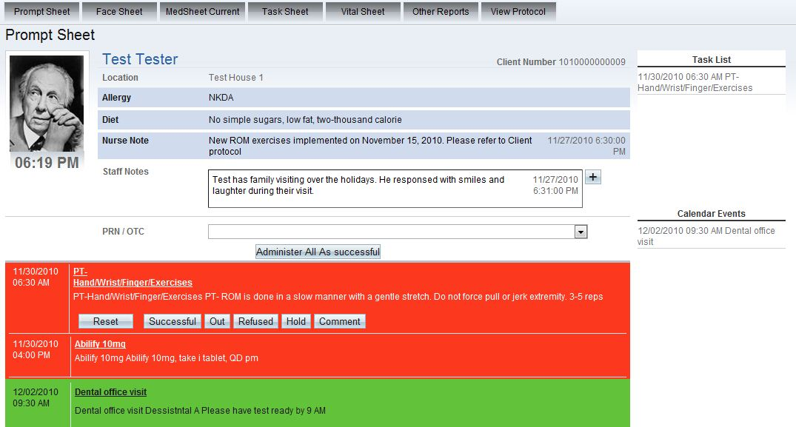
Time Based Prompting System Integrates Medications, Vitals and Tasks

Slide 100
Long Term Goal
Through the application of technology, we will improve access and availability of supportive services for individuals with developmental and other disabilities so that they may lead fulfilling lives in their homes and communities.

Slide 101
VARIETY OF REMOTE MONITORING SYSTEMS
Cameras
    PTZ – Fixed Units
Motions Sensors
    Detect Falls/Proximity
Security/ Health and Safety Sensors
    Doors/Windows - Alarms
GPS- Community
Remote Health Monitoring
RFID – Specific Location
    Environmental Control
    Data - Trends

Slide 102





Energy Management
Energy Efficiency
Intelligent Monitoring –Data Mining to Create Usage Profiles
Create and Optimize Load Profiles
Integrate Adaptive Technology with GridAgents Technology
Notes:
102

Slide 103

Current and Potential Research
Working with Colorado WIN Partners
Identified 31 areas of research
  Quality of Life
  Effectiveness of services
  Provide Cost and Energy Savings
  Improved Health and Safety
Funded through Grants

Slide 104
RESEARCH QUESTION
Does living in the Bob and Judy Charles Smarthome enhance the quality of life for the residents?
Quality of Life Indicators Studied
  Increased service to customers
  Increased active participation with community
  Increased communication
  Increased independence
  Improved health
  Satisfaction with services provided through the SmartHome
Notes:
These research questions were developed by Imagine! And Colorado WIN Partners in December of 2008.
4 research areas were discussed. The research question that elicited the biggest interest to Imagine & WIN Partners was how to Enhance the quality of life for consumers.
The following is a list of the areas WIN Partners addressed in our data collection and analysis.
Increased service to customers –
Increased active participation with community –
Increased communication –
Increased independence –
Improved health –
Satisfaction with services provided through the SmartHome-

Slide 105
RESULTS -CHOICES AND DECISION MAKING
There was a large increase in residents’ perception in control of their own lives.
5 resident’s mean scores stayed the same or increased
  2 resident’s mean scores increased by one point
  1 resident’s mean scores increased by two points
  2 resident’s mean scores increased by 4 points
1 resident’s mean scores decreased by 3 points
Notes:
Measures the level of which resident has control in choosing , for example where to work and where to live
Overall, 5 out of 6 residents scores all increased, while only one resident had a decrease in score for Choices and Decision Making 1

Slide 106
RESULTS - RESPECT AND RIGHTS
Overall, there was a slight increase in feeling of being respected by others around them.
4 resident’s mean scores stayed the same or increased
  1 resident's score stayed the same
  2 resident’s scores increased by two points
  1 resident’s mean scores increased by 4 points
2 resident’s mean scores decreased
  1 resident’s mean score decreased by one point
  1 resident’s mean score decreased by 2 points
Notes:
Measures the extent to which residents feel respected by others in their home, at work, etc.
Overall, most residents scores stayed the same or increased in their feelings of respect by others from the time before they moved into the Smarthome
However, 2 resident’s scores decreased indicating a change in their feelings of respect by others

Slide 107
SUPPORTS INTENSITY SCALE – SIS OVERVIEW
Evaluate and measure the type, frequency and intensity of supports needed for an individual with a developmental disability in 85 area covering the following domains:
  Home Living
  Community Living
  Lifelong Learning
  Employment
  Health and Safety
  Social
  Protection and Advocacy
  Medical
  Behavioral
Collected directly from participants in a structured interview format.
Notes:
Supports Intensity Scale (SIS): Identifies the type, frequency and duration of supports needed for an individual receiving services in order to complete particular tasks or participate in particular activities.
This information is collected through an informal interview.
SIS covers different domains, or categories, of support needed:
Home Living Activities
Community Living Activities
Lifelong Learning Activities
Employment Activities
Health and Safety Activities
Social Activities
Each domain has 8 questions. For each question there are three answers that need to be addressed: 1. What type of support would be needed for that activity? 2. How frequently would that support be needed? 3. How much time in one given day would that support take?
Responses to the questions are chosen from the rating key of the assessment.
Type of support: “What type of support would be needed?”
0=none
1=monitoring
2=verbal/gesture prompting
3=partial physical assistance
4=full physical support
Frequency: “How frequently would that support be needed?”
0=none or less than monthly
1=at least once a month but not once a week
2=at least once a week but not once a day
3=at least once a day but not once an hour
4=hourly or more frequently
Daily Support Time: “How much time in any given day would that support take?”
0=none
1=less than 30 minutes
2=30 minutes to less than 2 hours
3=2 hours to less than 4 hours
4=4 hours or more
Uses for SIS:
Created for measuring and planning supports and services for person with intellectual disabilities.
Can develop Individualized Services Plans and track and decrease or increase in support needs overtime.
Plan for supports that will improve independence and quality of life.
Supports refer to an array of resources and strategies including individuals, agencies, money or tangible assets, assistive devices or environments that enable people with developmental disabilities live in typical community settings.
“Rather than mold individuals into pre-existing diagnostic categories and force them into existing models of service, the supports approach evaluates the specific needs of the individual and then suggests strategies, services and supports that will optimize individual functioning.”
**SIS info/goals goes along with the basic tenants of the SmartHome and Imagine!. Like Sterling told me – “to rethink the way we have always thought.”

Slide 108
CHANGES IN SIS OVERALL RATINGS
SIS Support Needs Index
Support Needs Score
Notes:
Support Needs Index is a single score indicating the overall level of supports needed for the individual. This is done by taking the raw scores of each Activity Subscale as ranked during the interview. Then using Standard Scores and Percentiles as noted in Appendix 6.2 to get to the Composite Standard Score (Appendix 6.3). These numbers represent the overall support needs of each individual from Round 1 which was administered prior to the residents moving into the SmartHome (Range from 2006-2008) and Round 2 which was administered August 2010, 1 year after moving into the SmartHome.
Mandy – Increase of 3 (47-50)
Rae – Decrease of 15 (18-3)
Gerald – Remained the same (82)
John – Decrease of 3 (7-4)
Rebecca – Remained the same (13)
Chris – Decrease of 41 (55-14)
Donna – Decrease of 2 (37-35)
Lana – Decrease of 12 (14-2)

Slide 109
PATTERNS IN SIS CHANGES
Part B: Community Living Activities
  Q1 – Getting from place to place throughout the community
Notes:
Part B: Q1 – Getting from place to place throughout the community
Handheld GPS Device (UMPC) – Not rugged enough.
Rae – Time 1: 7 (2,2,3), Time 2: 0 -**SmartHome staff know what factors resulted in this change?
Chris – Time 1: 11 (3,4,4), Time 2: 0 – Possible result of the UMPC?
Lana – Time 1: 8 (3,2,3), Time 2: 0 – SmartHome staff know what factors resulted in this change?
***PICTURE OF TECH BEING USED – UPMC being used by Chris

Slide 110
Areas of Development
Consumer Assessment
Integrating Multiple IT Platforms
DSP Training
Product Development and Assessment
  Adaptive Equipment
  Behavioral Supports
  Behavioral Patterns Recognition through Energy Usage
  Social Networking
Capturing Life History
Remote Monitoring Waivers

Slide 111
Check us out
SmartHomes - http://Imaginesmarthomes.org
FaceBook – http://www.facebook.com/pages/Imagine-SmartHomes/86609388388
Twitter
http://twitter.com/ImagineColorado
Notes:
111

Slide 112
Thoughts! Questions?
Mark Davis
Ohio Provider Resource Association
1152 Goodale Boulevard
Columbus, Ohio 43212
614.224.6772
mdavis@opra.org
Greg Wellems
Imagine!
1400 Dixon Ave
Lafayette, Colorado 80026
303.926.6466
gwellems@imaginecolorado.org

